Slide 1
Molecular Biodiversity of the Plant in Africa, beyond the DNA Barcoding
Dong- Jin Kim
Nelson Mandela African Institute
of Science and Technology
Arusha, Tanzania
PRAGMA 23, Biodivesrity Workshop
Kunkuk Univ., Seoul., KOREA, Oct. 9 -12, 2012

Slide 2
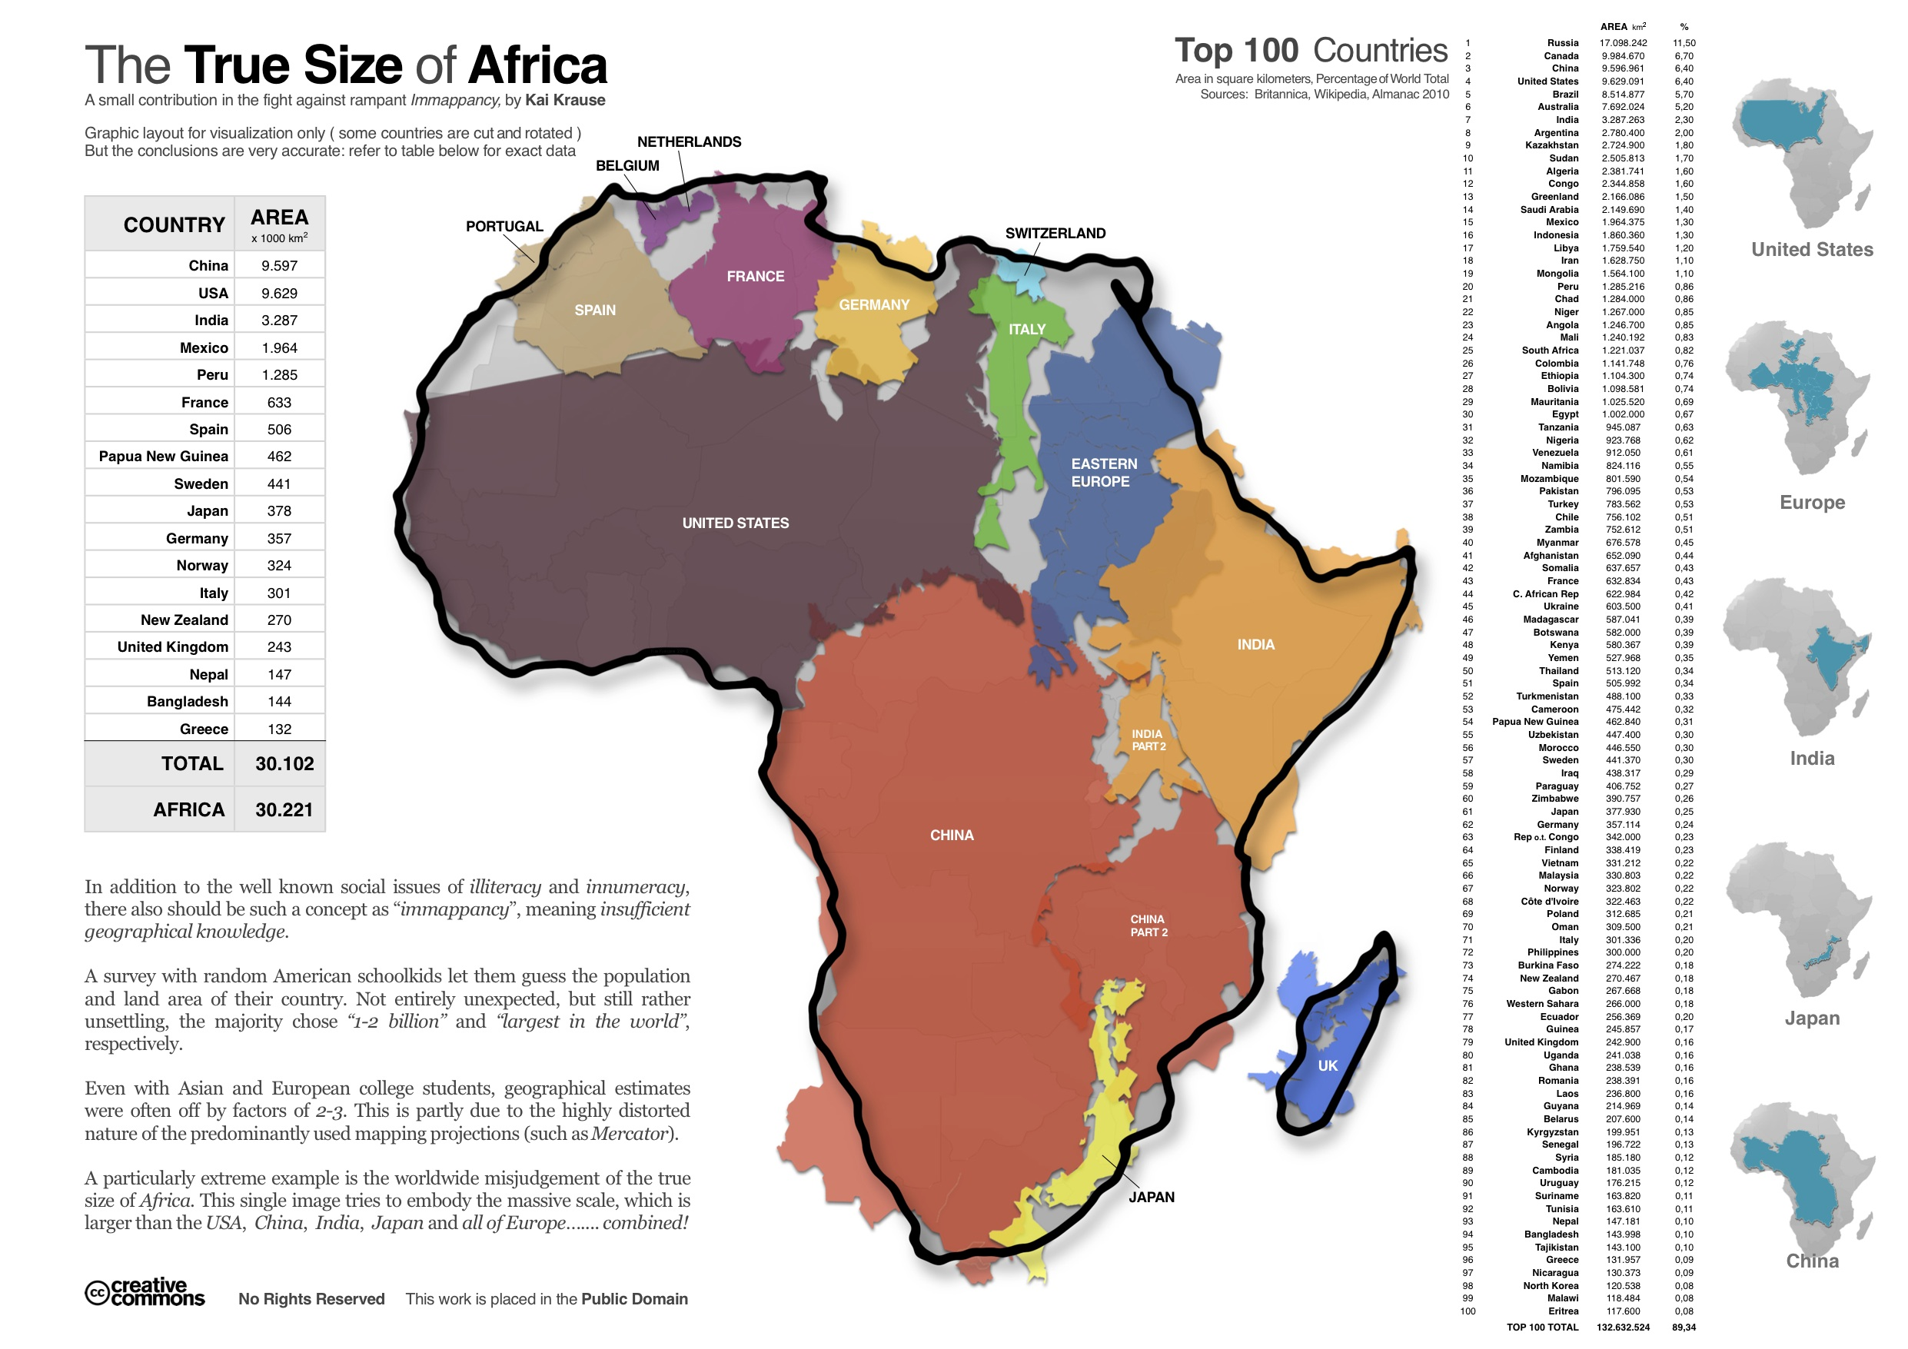

Slide 3


Slide 4
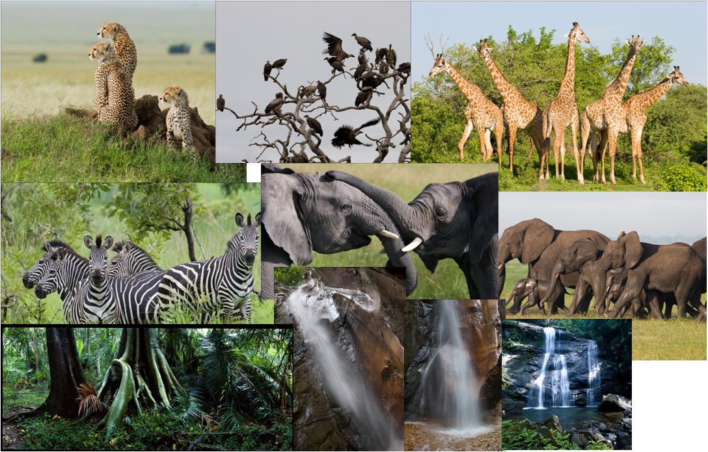
The Biodiversity and Tourist Industry around Arusha (contd)

Slide 5
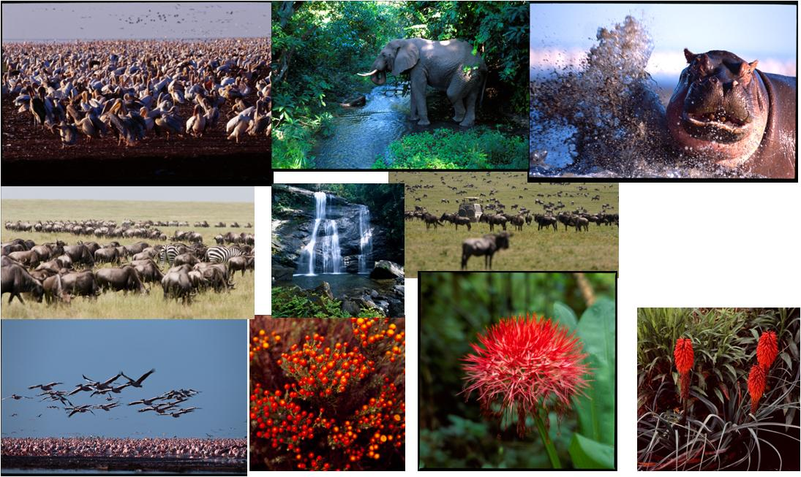
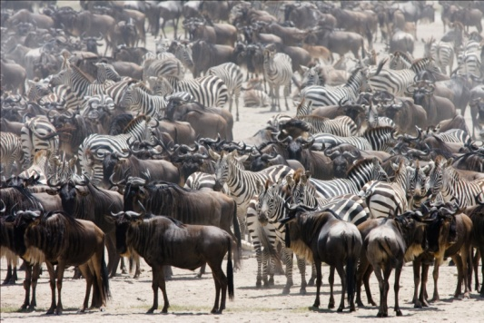
The Biodiversity and Tourist Industry around Arusha (contd)

Slide 6
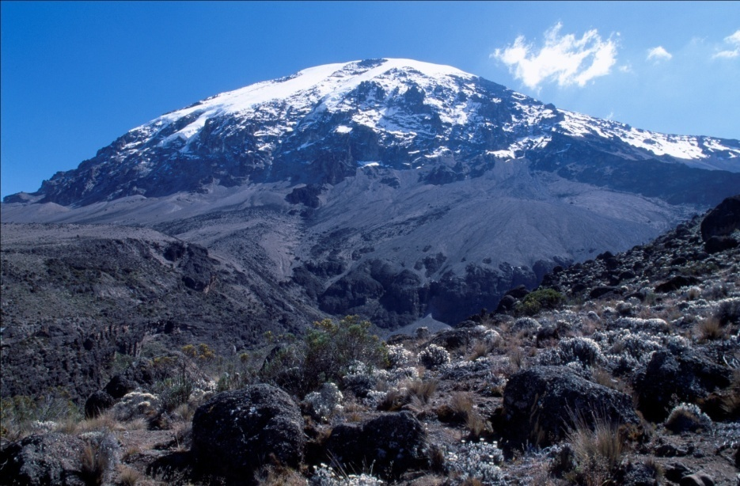
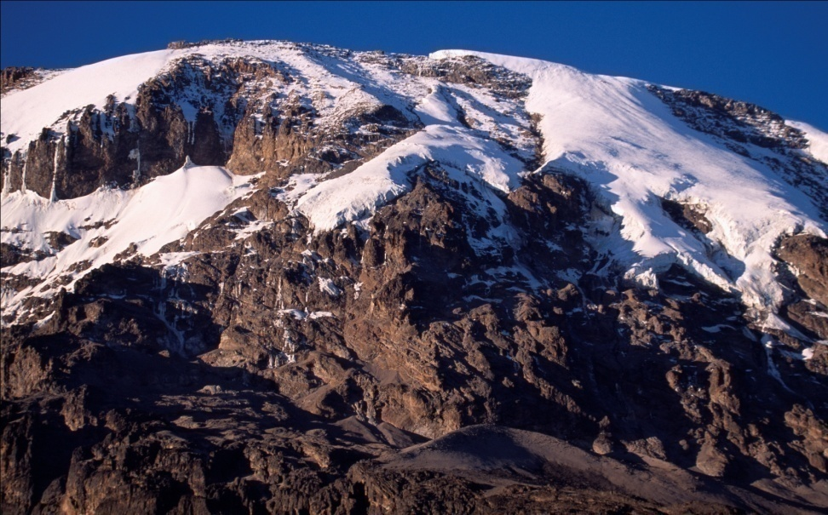
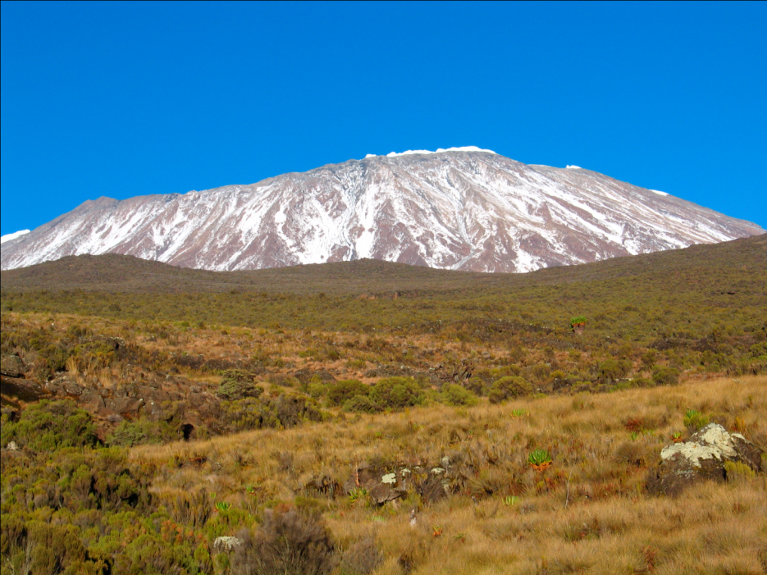
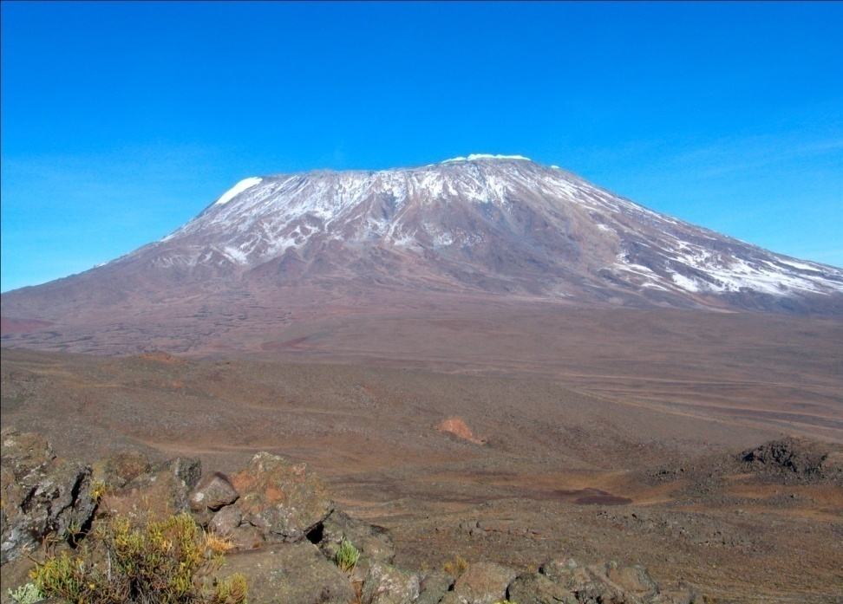
Mountain Kilimanjaro, the Highest Mountain in Africa, 5,895 m

Slide 7
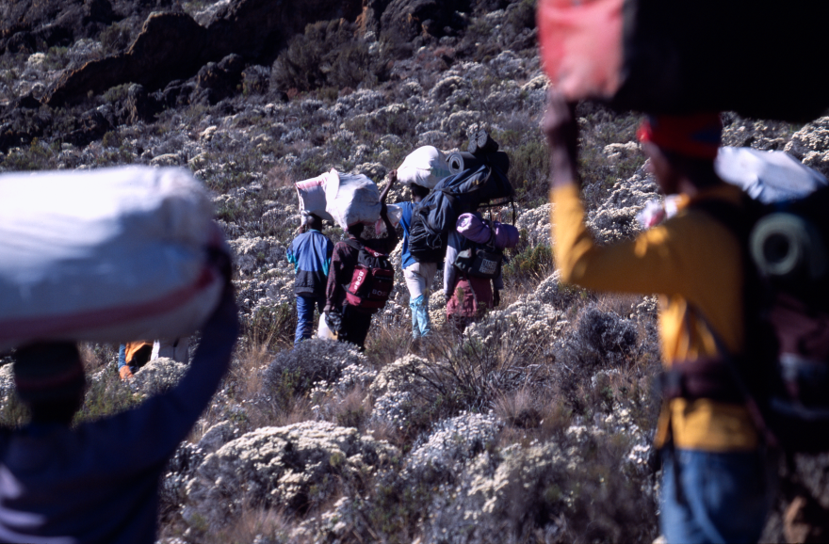

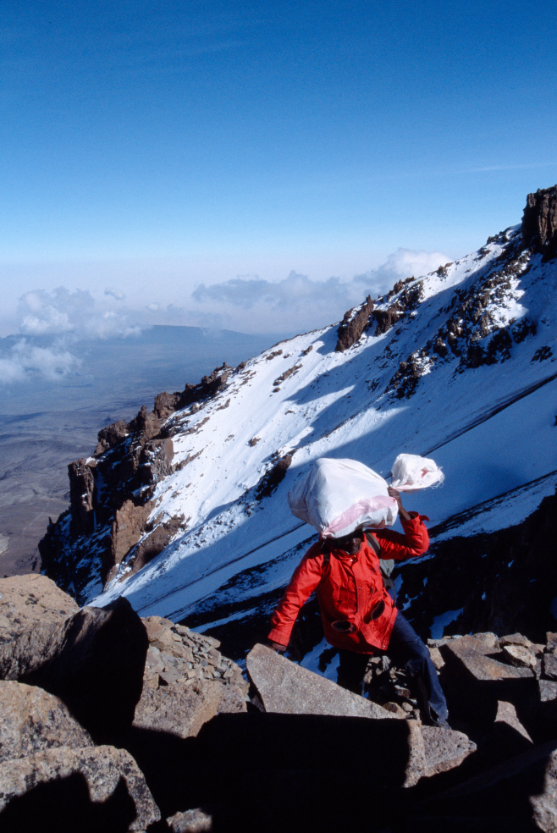
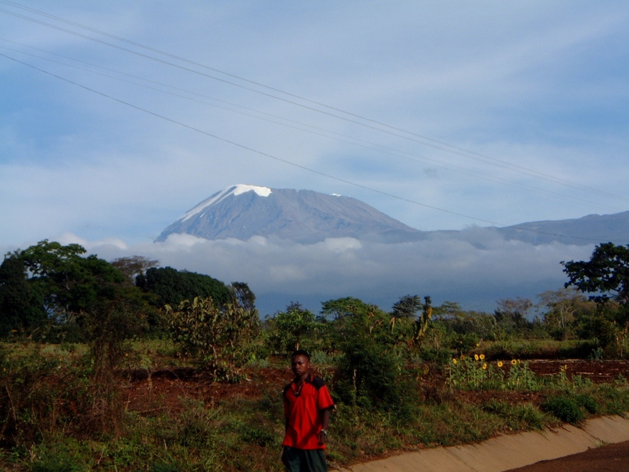
Mountain Kilimanjaro, the Highest Mountain in Africa, 5,895 m (contd)

Slide 8
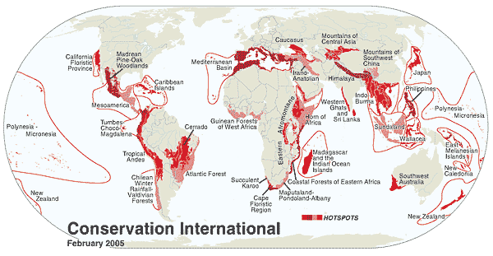
Biodiversity:
Article 2 of the Convention of Biological Diversity (CBD) provides a short description of the term `biodiversity', which refers essentially to the diversity of living organisms, the genes they contain, and the communities to which they contribute.

Slide 9
Three Levels of Biodiversity
Ecosystem Diversity :
the least-understood, trying to understand all the species in an ecosystem and how they affect each other and their surroundings while at the same time being affected themselves, is extremely complex
Species Diversity :
Most studies, either theoretical or experimental, focus on the species level, as it is the easiest to work on both conceptually and in practice.
DNA barcoding is the molecular approach for the species diversity.
Genetic Diversity : Genetic diversity is the variety present at the level of genes. Genes, made of DNA, are the building blocks that determine how an organism will develop and what its traits and abilities will be. This level of diversity can differ by alleles, by entire genes, or by units larger than genes such as chromosomal structure.
Chemical diversity
Notes:
three levels of biodiversity: genetic, species, and ecosystem.
These levels are all interrelated yet distinct enough that they can be studied
as three separate components. Some researchers believe that there are fewer or more
levels than these, but the consensus is that three levels is a good number to work with.

Slide 10
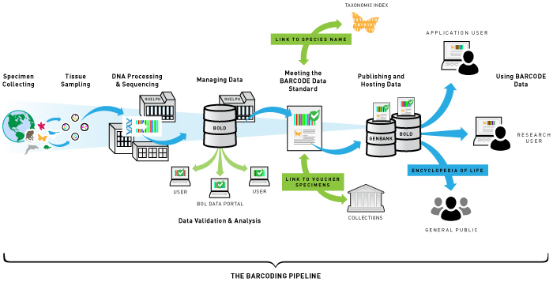
DNA barcoding:
- An international consortium, the ‘Barcode of Life Initiative’
- identification of the estimated 10 million species on Earth.
- a diagnostic technique in which short DNA sequence(s)
Sample → DNA → PCR → sequencing → sequence analysis

Slide 11
DNA barcoding of the medicinal plants from Kenya and Tanzania
the herbal medicine powder → DNA analysis
useful for the standardization of the herbal medicines.

Slide 12
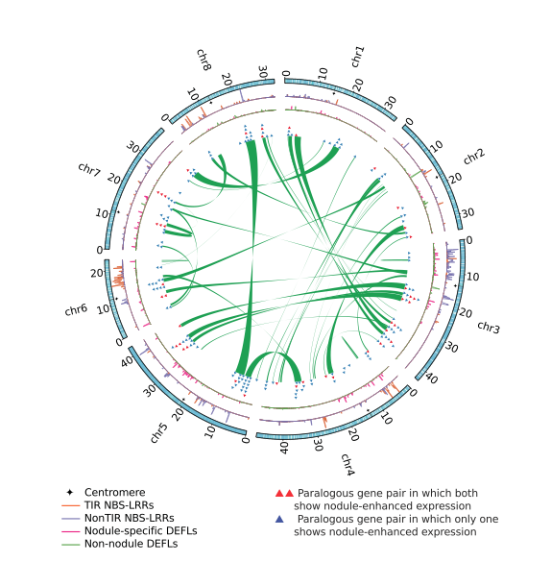
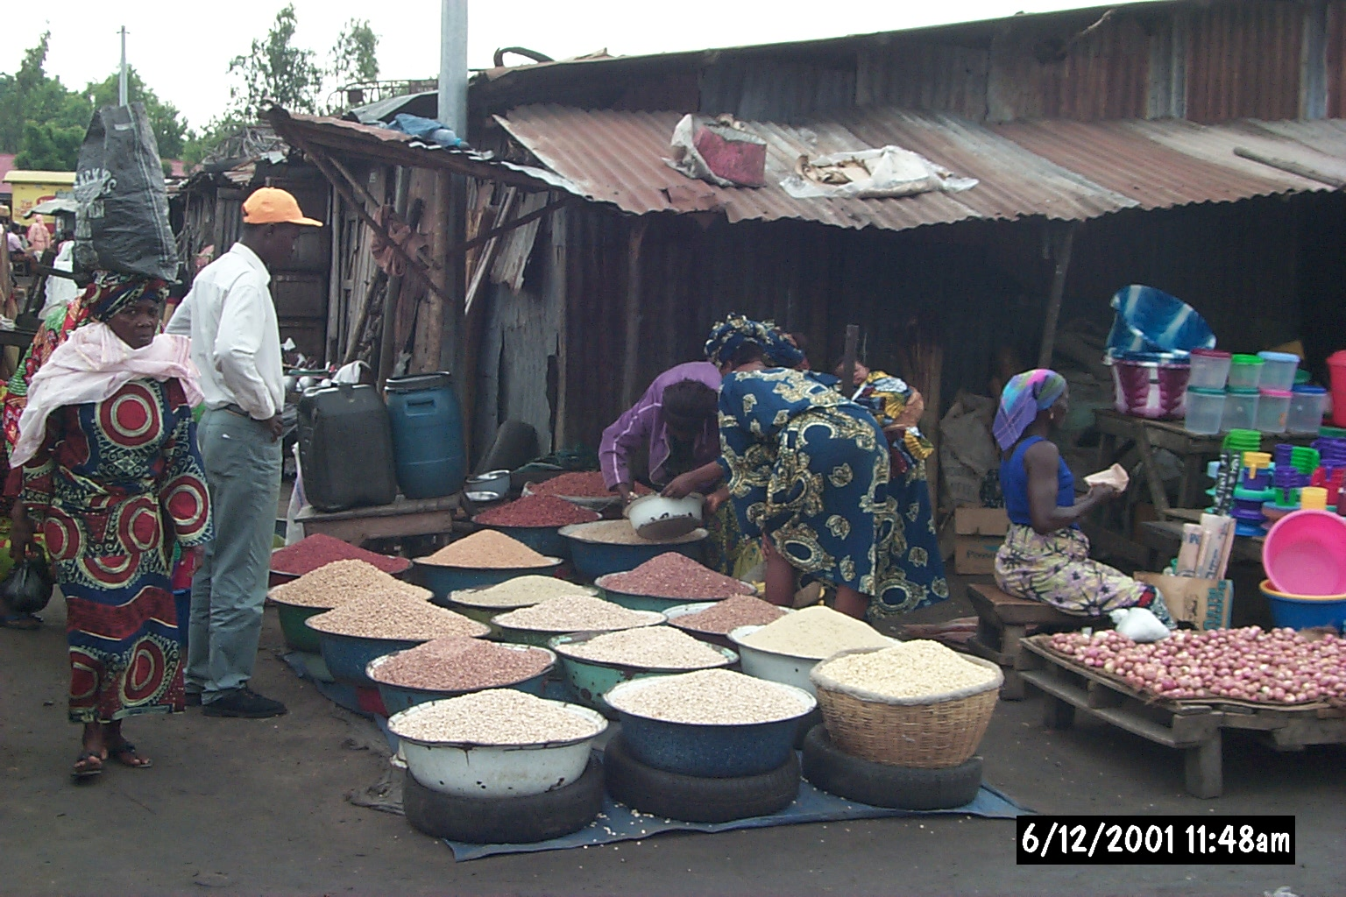
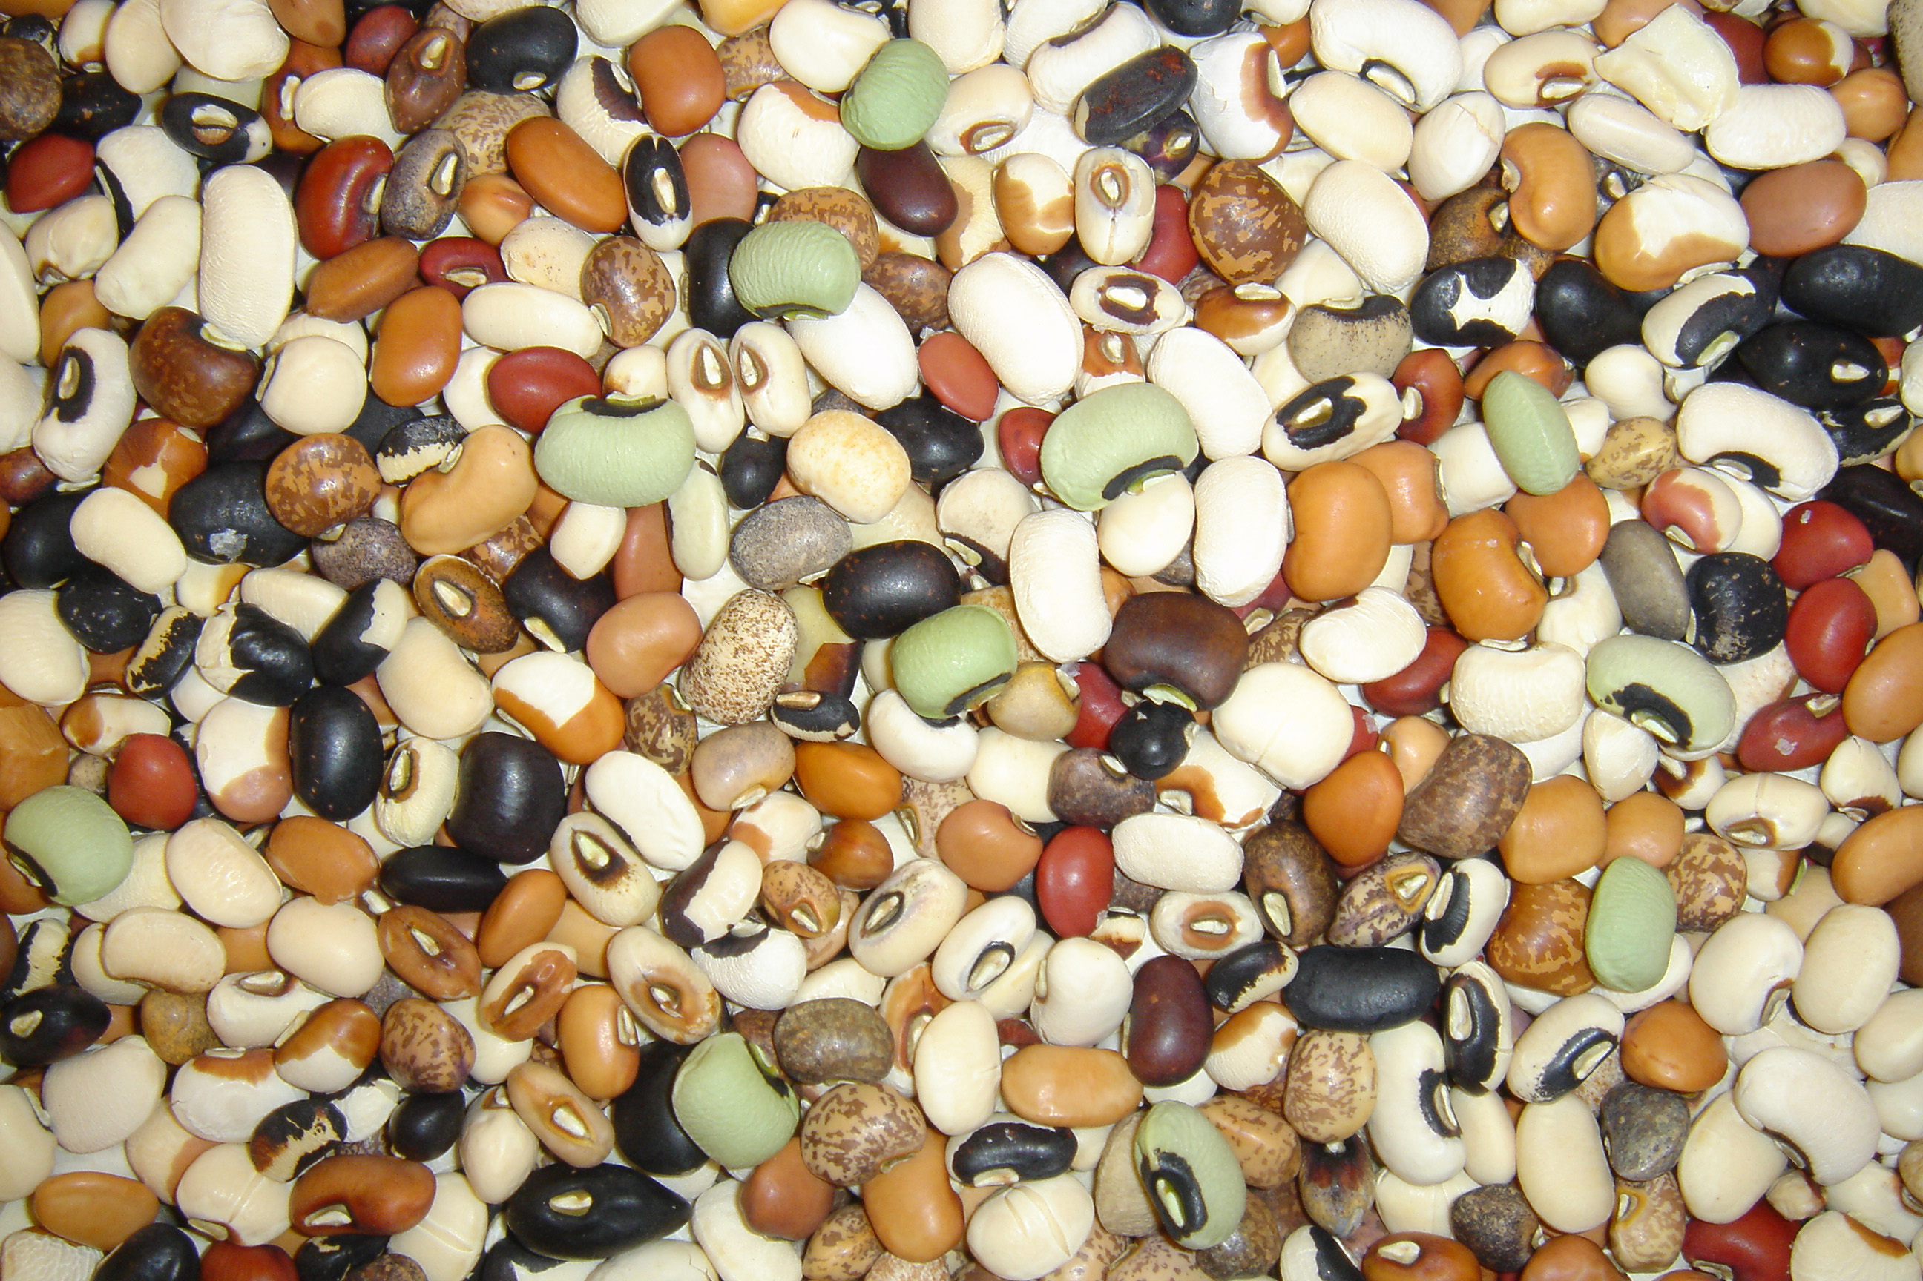
Legumes : Main Protein Source
Species relation
Genome relations
Lotus
Sesbania
Anthyllis
Galega
Vicia
Pisum
truncatula
Melilotus
Cicer
Medicago
sativa
Phaseolus
Vigna
Glycine
Cajanus
How can we put this genetic variation to the improved variety, and finally to the markers for income increases??

Slide 13
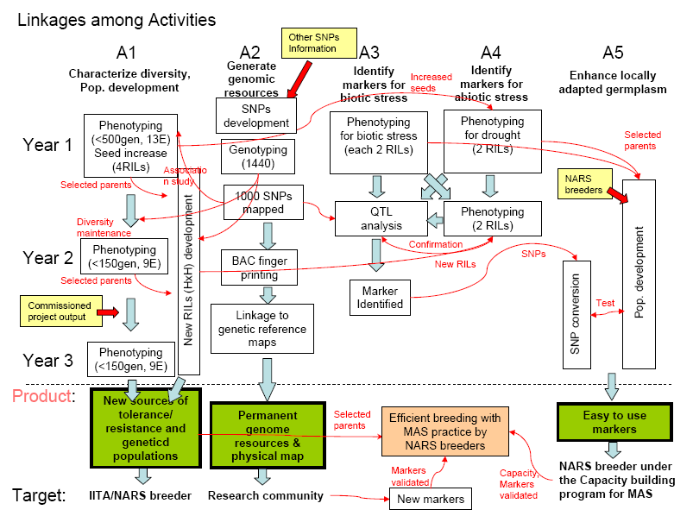
An example of crop improvement program by molecular breeding, Cowpea
Genptyping by Sequencing

Slide 14
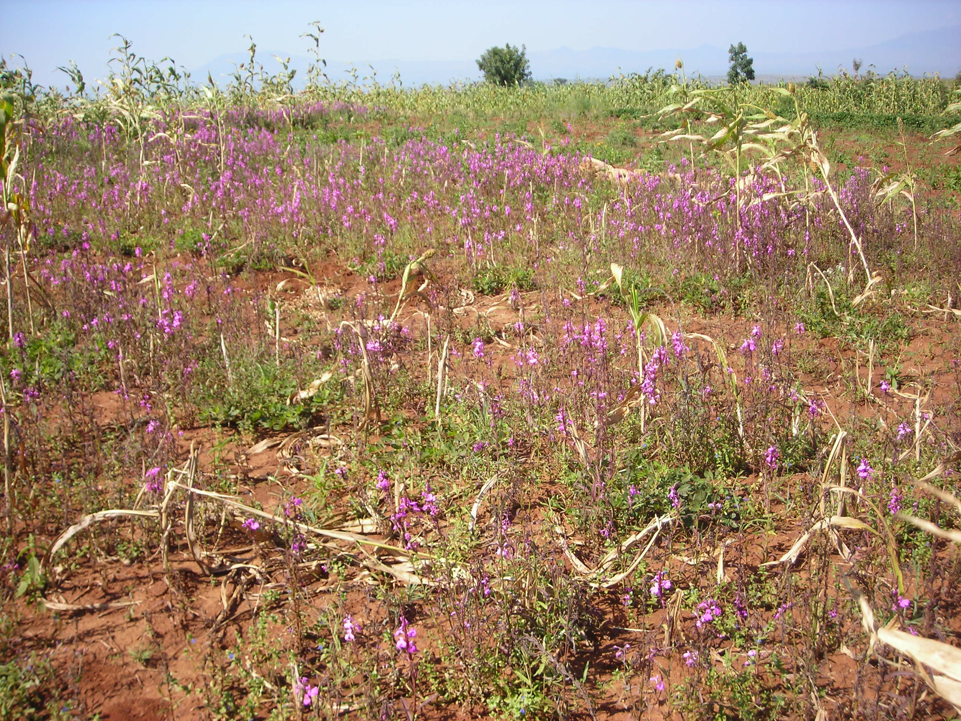
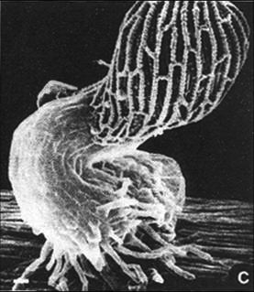
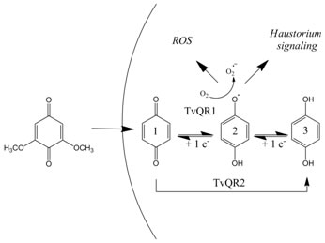
Striga in the maize field
an example of chemical ecology
Signaling for Haustorial dev.

Slide 15
Molecular biodiversity , Chemistry Approach
Ex). Phytochemistry of the whole plant extract of Striga
one of the most serious constraints to cereal crops production in Africa
- has been used as a traditional medicine
Major ions observed in LC-MS/MS analysis
HPLC chromatogram (280 nm)
Mass Spec profile

Slide 16
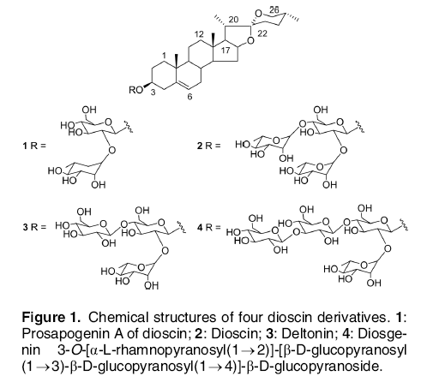
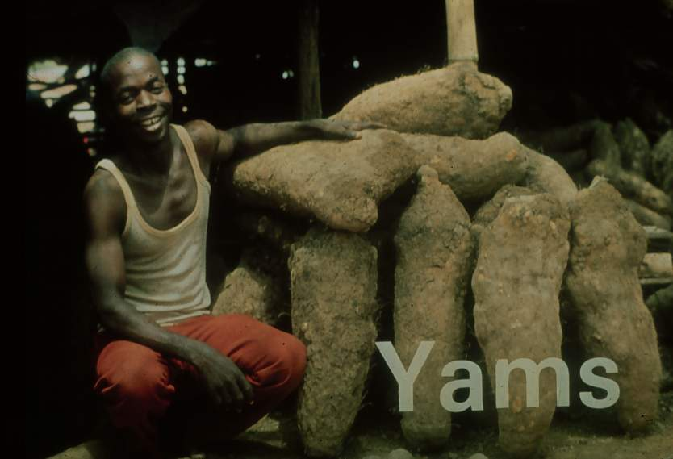
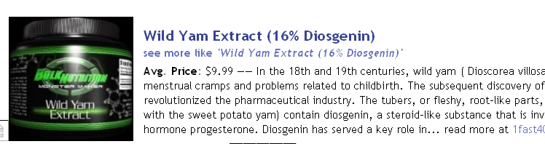

Slide 17
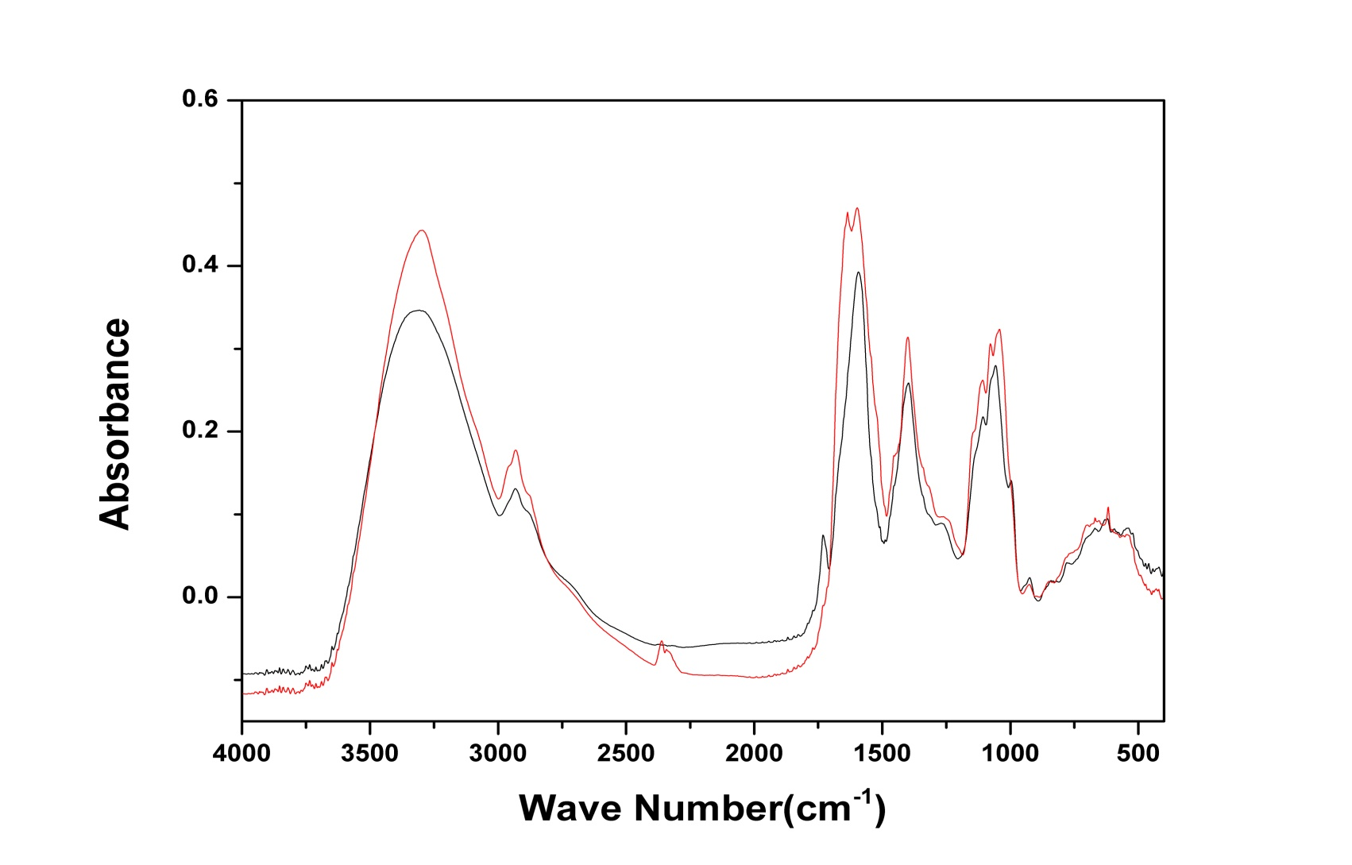
Representitive FT-IR spectrum of
Yam samples (D. alata, D. dometorium)
D.alata
D.dometorium

Slide 18
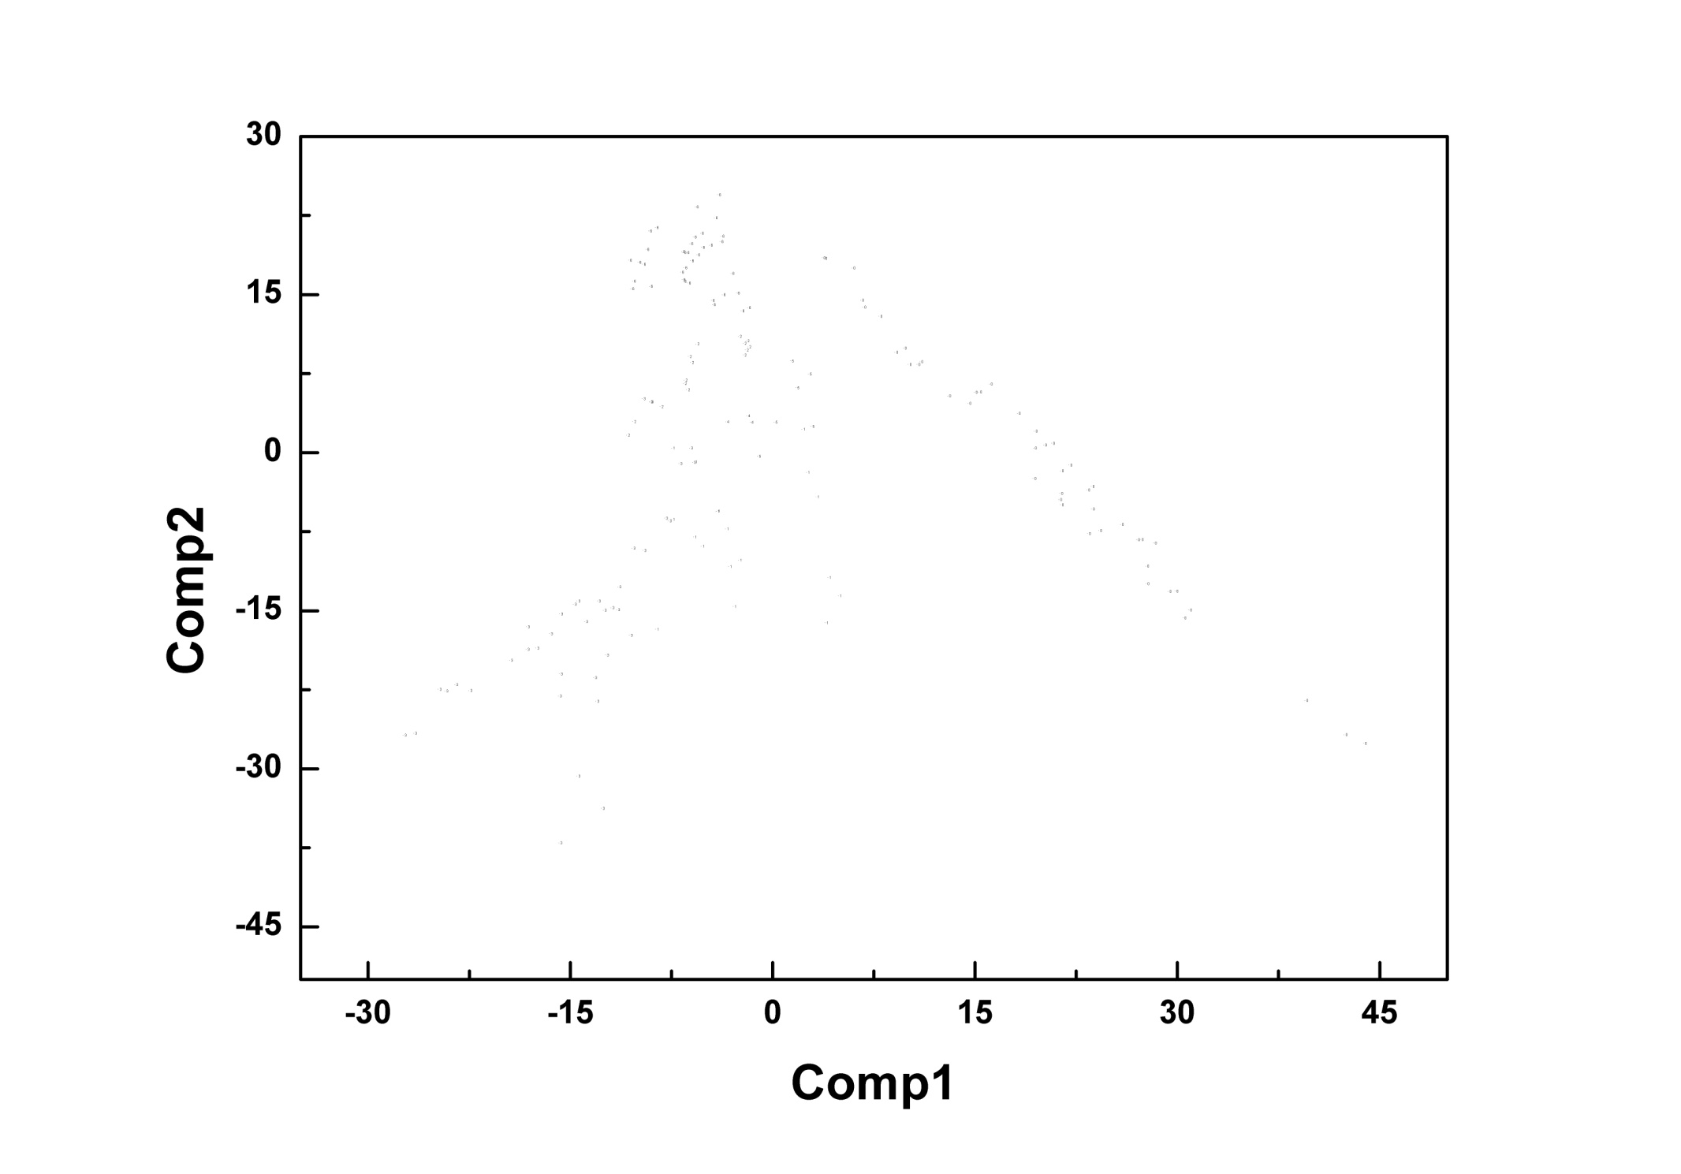
PLS-DA score plot of Yam samples
(total 55 lines)
D. alata
D. bulbifera
D. cayenesis
D. dometorium
D. mangenotiana
D. prahensilis
D. rotundata
Notes:
18

Slide 19
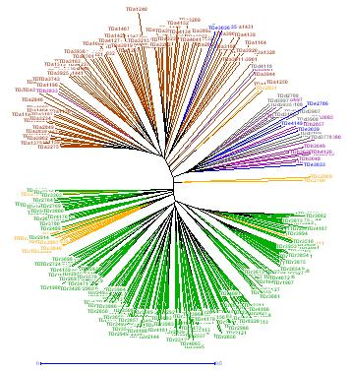
Genetic diversity of 342 yam accessions base on SSR data
Dendrogram from PLS DA score plot of Yam samples (total 63 lines)
D. rotundata
D. cayenesis
D. spp KN1
D. spp KE1
D. spp KG2
D. mangenotiana
D. spp KNK2
+ Dioscin
D. prahensilis
D. spp KNK4
D. spp KNK1
D. spp KG1
D. spp KE2
D. bulbifera
- Dioscin
D. alata
D. dumetorium
D. batatas (Jangma)
D. japonica (Sanma)
D. opposita (Dunggunma)
120
100
80
60
40
20
0

Slide 20

beyond DNA barcoding : Molecular Biodiversity
- Genomics
genome sequencing
High throughput processing
Metagenomics approach
- Metabolomics
- Proteomics
Genome Database
Bioinformatics
Chemiinformatics
Gene
→
protein
Drug/compound
→
activity

Slide 22
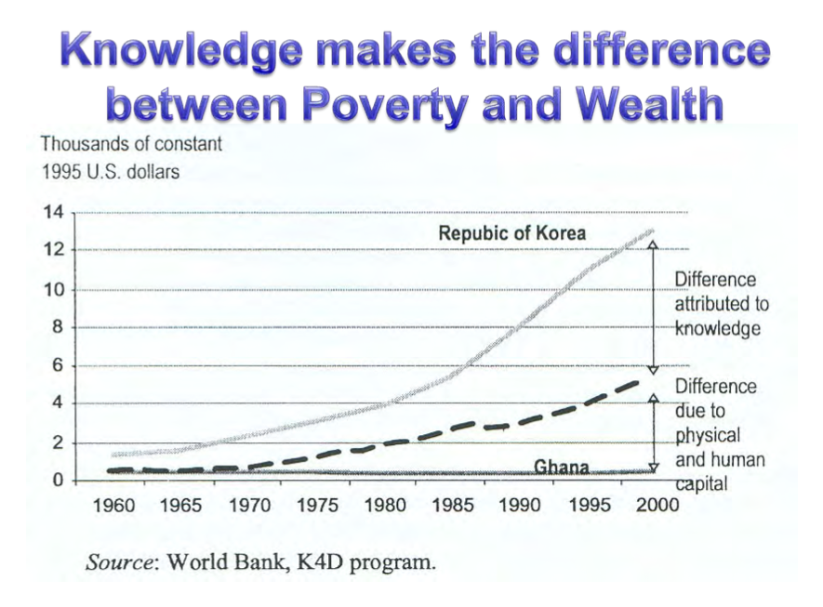

Slide 23
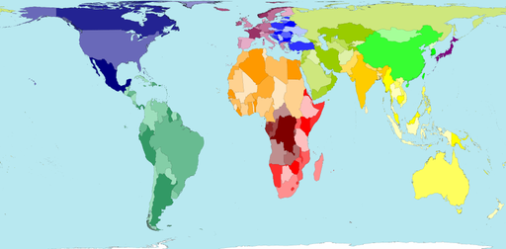
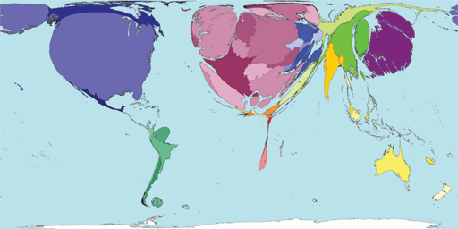
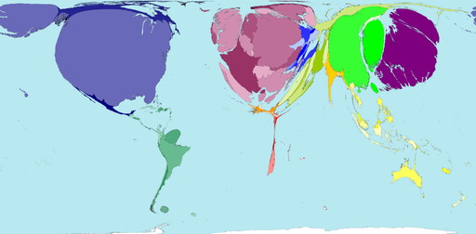
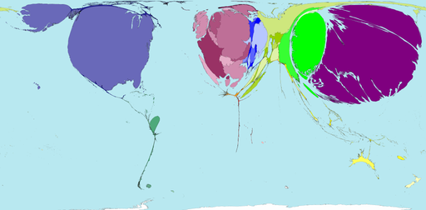
Science & Technology Performance
– a function of Value-addition to Human Capital
Physical
Scientific research
R&D expenditure
Patent registration
Source: www.worldmapper.org
“… in the final analysis it is basically the mystery and utilization of modern science and technology which distinguishes the South from the North”. Abdus Salam African Nobel Laurete, 1979

Slide 24
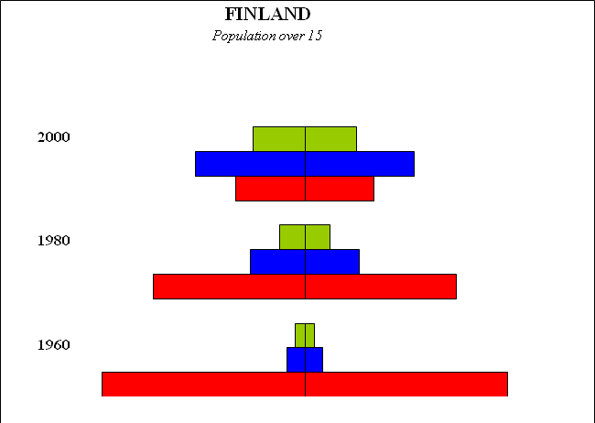
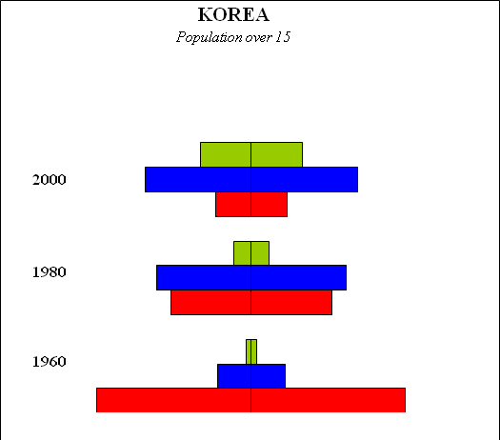
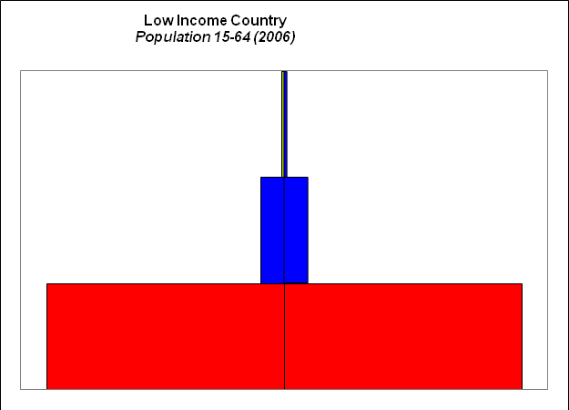
Value addition to Human Capital – Finland & Korea, & LDC
Red = Post Primary, Blue = Post Secondary, Green = Post Tertiary
Source: World Bank, 2010

Slide 25
Origin of the AIST Concept
African leaders (incl. Nelson Mandela) discussion with Jim Wolfensohn
(then WB President), 2000/01.
Nelson Mandela greatly concerned by the knowledge gap (knowledge deficit) in SSA suggested to Jim that Institutes of S&T are perhaps Africa’s single greatest need
(the likes of IITs & IISs in India).
Frannie Leautier,
then Vice President
of WBI, was given the task of making this happen.
Hippolyte Fofack, an African WBI official, was charged with developing the concept in collaboration with some Africans in the Diaspora.

Slide 26
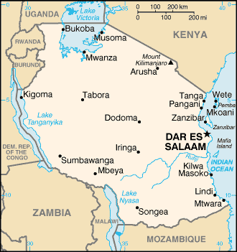
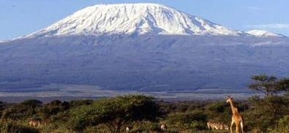
Tanzania selected
to host the AIST
for the EA Region

Slide 27
To provide the best facilities for graduate and post-doc studies and research
Strong link with industry for technology transfer
To bridge between research and industrial development
Objectives
of the AISTs
To catalyze the development of world class science and technology in Africa
Technology parks with incubators and innovation centres for spin-offs
Notes:
27

Slide 28
Structural Pillars of NM-AIST
ICT
Resource
Centre
NM AIST
Schools &
Departments
Technology
Park
(Incubators &
Innovation Centre)
Eco Park
(Botanicals, etc)
Academia for Society
and Industry

Slide 29
NM-AIST
Is for research intensive graduate and post-doc training in SET, viz. a Research University.
Maintains strong national and regional ownership.
Its vision is to become a world-class institution dedicated to the pursuit and promotion of excellence in SET, and their applications for economic growth and sustainable development.

Slide 30
Key Deliverables
Production of:
Establishment of a world-class environment for the generation and application knowledge (through research, innovation and technology development) for wealth creation and sustainable development.
Top-notch SET academics for higher learning institutions;
Competent researchers for R&D institutions;
Techno-prenuers, industry captains, innovation managers for stimulating, catalyzing and promoting business start-ups and the growth of the local industry.

Slide 31
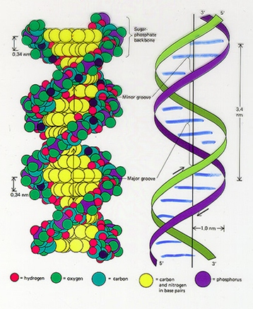

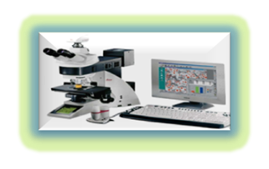
Life Sciences and Bioengineering (LSBE)
Biological Engineering
Biodiversity Conservation &
Management
Food Science & Industrial Biotechnology
Sustainable Agriculture, Plant and Animal Biotech
Health and
Medical Biosciences
Biological Engineering
Biodiversity Conservation &
Management
Food Science & Industrial Biotechnology
Sustainable Agriculture, Plant and Animal Biotech
Health and
Medical Biosciences

Slide 32

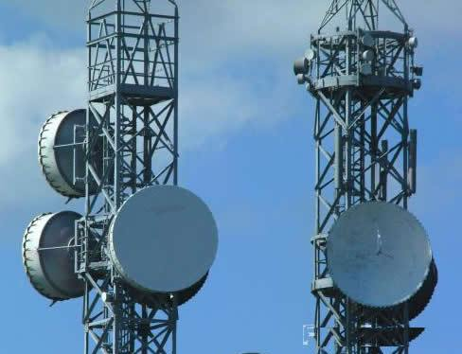

Mathematics, Computational & Communication Science & Engineering (MCCSE)
Information Technology, Development & Management
Communication Science & Engineering
Mathematics & Computational Science
Applied Mathematics & Computational Engineering
Information Management & Communication Technology
Computational Science & Engineering
Telecommunications Systems & Engineering

Slide 33
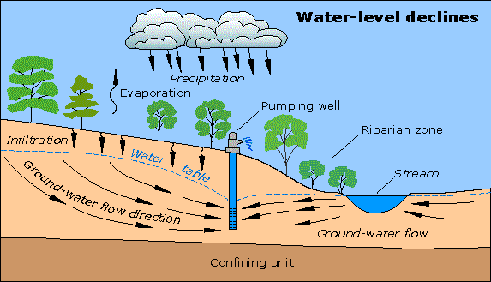

Water & Environmental Science & Engineering (WESE)
Hydrology and Climate Change
Irrigation Engineering
Environmental Science
Environmental Engineering
Hydrology and Water Resources Engineering
(HWRE)
Environmental Science and Engineering
(EnSE)

Slide 34



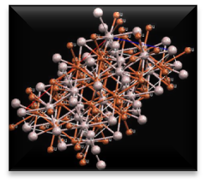
Materials Science and Engineering (MaSE)
Bio & Polymeric Materials
Electronic Materials
Metallic Materials
Smart Materials
Ceramic Materials

Slide 35
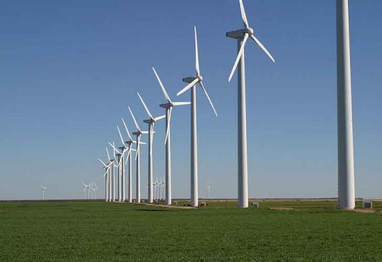
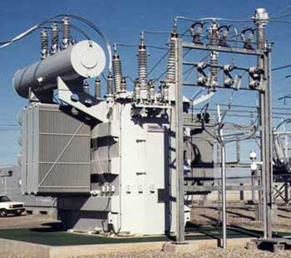
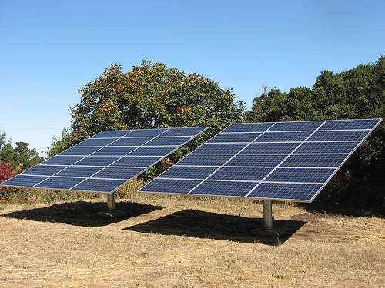
Sustainable Energy Science and Engineering
(SESE)
Sustainable Energy Generation and Utilization
Nuclear Power Engineering and Technology
Bio Energy and Renewables

Slide 36
Business Studies and Humanities (BuSH)
Management & Entrepreneurship
Innovation Management
Innovation Systems & Clusters
IPR & Patent Management
Enterprise Development & Management
Philosophy, Law & Ethics
Communication Skills & Research Methodology

Slide 37
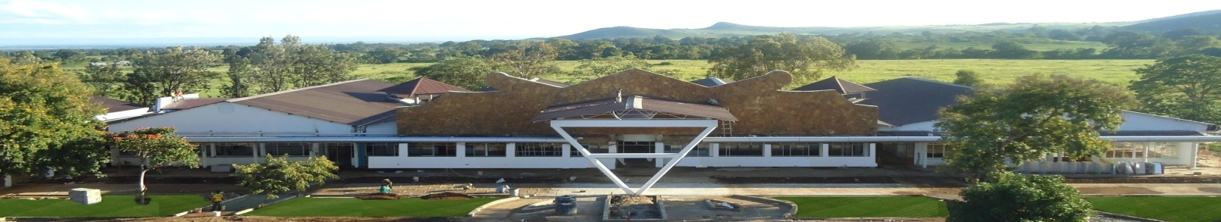
Thank you very much ! Asanteni Sana !

